Slide 1

Prismia.Chat https://tinyurl.com/y26ragof
Notes:
https://prismia.chat/projects/ccaebf77-a313-4f85-a7ee-4416aaaf014d/join

Slide 2
Types of image transformations

Slide 3
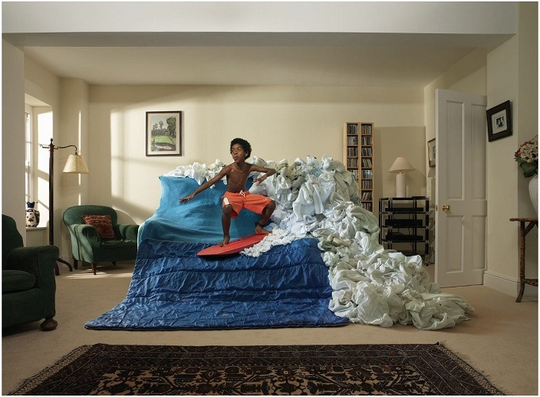
What is an image?

Slide 4


What is an image?
A (color) image is a 3D tensor of numbers.

Slide 5

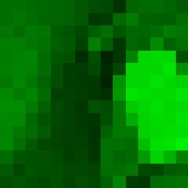




What is an image?
red
green
blue
Each channel
is a 2D array of numbers.
colorized for visualization
color image patch
How many bits are the intensity values?
actual intensity values per channel

Slide 6
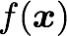
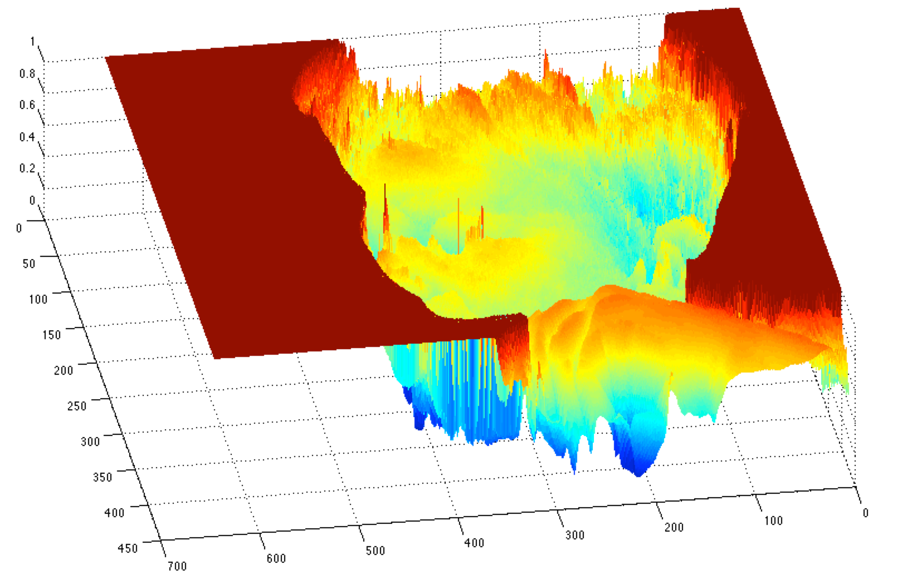
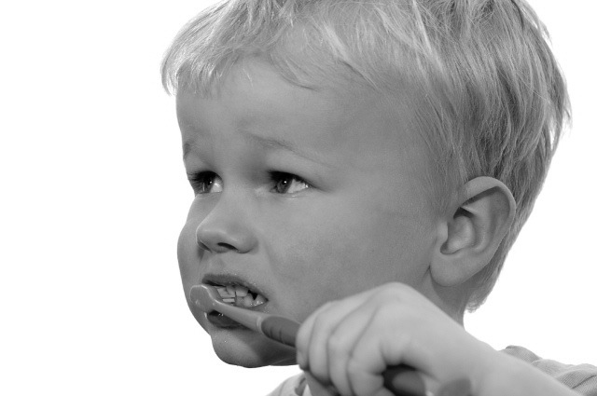
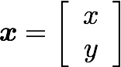
What is an image?
A (grayscale) image is a 2D function.
grayscale image
What is the range of the image function f?
domain

Slide 7
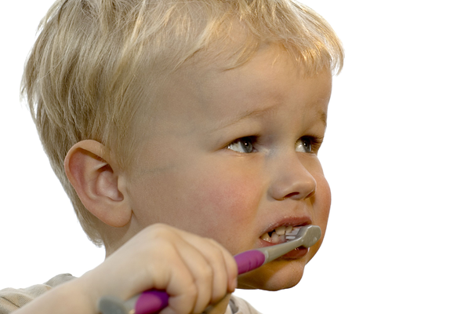
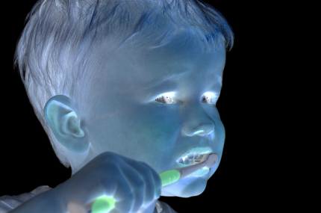
What types of image transformations can we do?
Filtering
Warping
changes pixel values
changes pixel locations

Slide 8
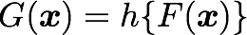
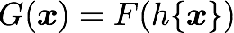
What types of image transformations can we do?
Filtering
Warping
changes range of image function
changes domain of image function

Slide 9
What types of image filtering can we do?
Point Operation
point processing
Neighborhood Operation
“filtering”

Slide 10
Point processing

Slide 11
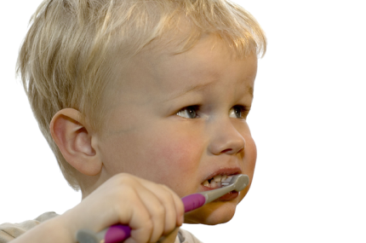
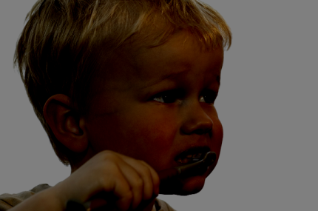

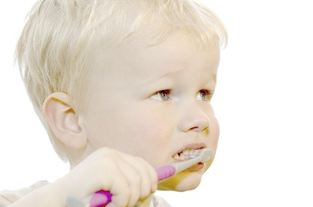
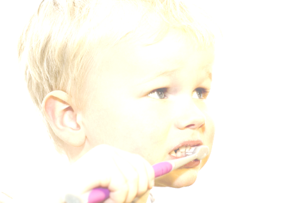

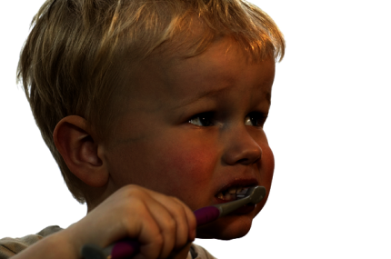
Examples of point processing
original
darken
lower contrast
non-linear lower contrast
invert
lighten
raise contrast
non-linear raise contrast

Slide 12
Examples of point processing
How would you implement these?
original
darken
lower contrast
non-linear lower contrast
invert
lighten
raise contrast
non-linear raise contrast

Slide 13
Examples of point processing
How would you implement these?
original
darken
lower contrast
non-linear lower contrast
invert
lighten
raise contrast
non-linear raise contrast

Slide 14
Examples of point processing
How would you implement these?
original
darken
lower contrast
non-linear lower contrast
invert
lighten
raise contrast
non-linear raise contrast

Slide 15
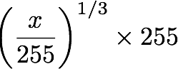
Examples of point processing
How would you implement these?
original
darken
lower contrast
non-linear lower contrast
invert
lighten
raise contrast
non-linear raise contrast

Slide 16
Examples of point processing
How would you implement these?
original
darken
lower contrast
non-linear lower contrast
invert
lighten
raise contrast
non-linear raise contrast

Slide 17
Examples of point processing
How would you implement these?
original
darken
lower contrast
non-linear lower contrast
invert
lighten
raise contrast
non-linear raise contrast

Slide 18
Examples of point processing
How would you implement these?
original
darken
lower contrast
non-linear lower contrast
invert
lighten
raise contrast
non-linear raise contrast

Slide 19
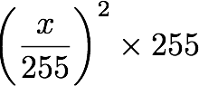
Examples of point processing
How would you implement these?
original
darken
lower contrast
non-linear lower contrast
invert
lighten
raise contrast
non-linear raise contrast

Slide 20
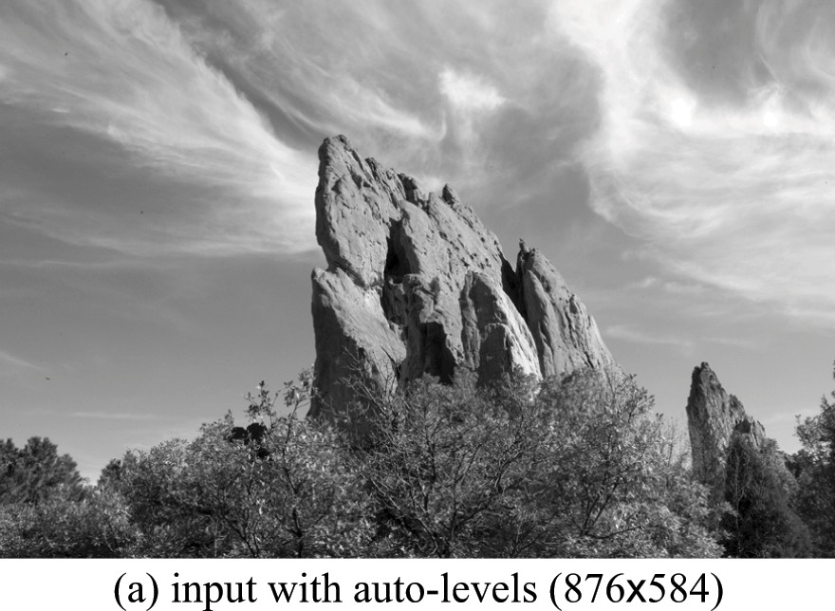
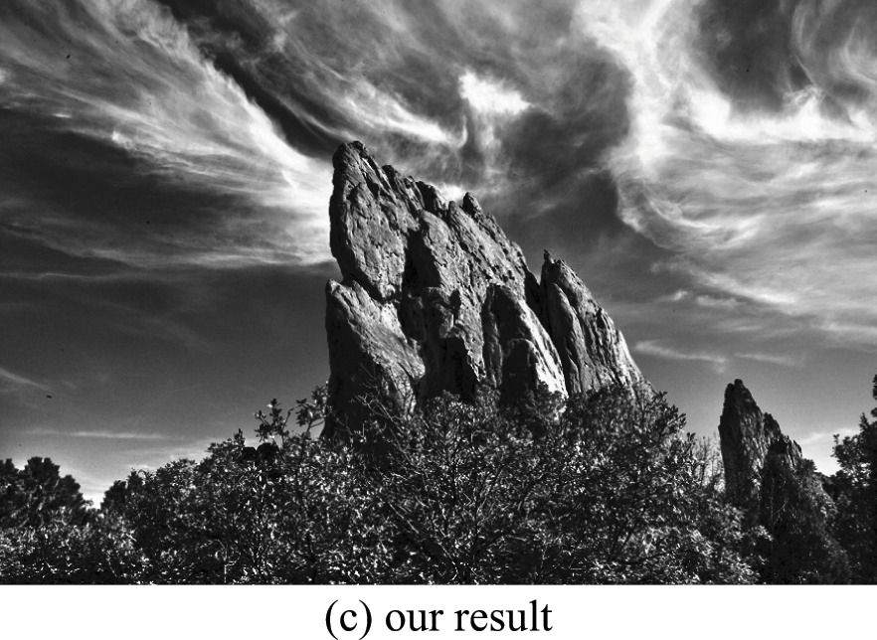
Many other types of point processing
camera output
image after stylistic tonemapping
[Bae et al., SIGGRAPH 2006]

Slide 21
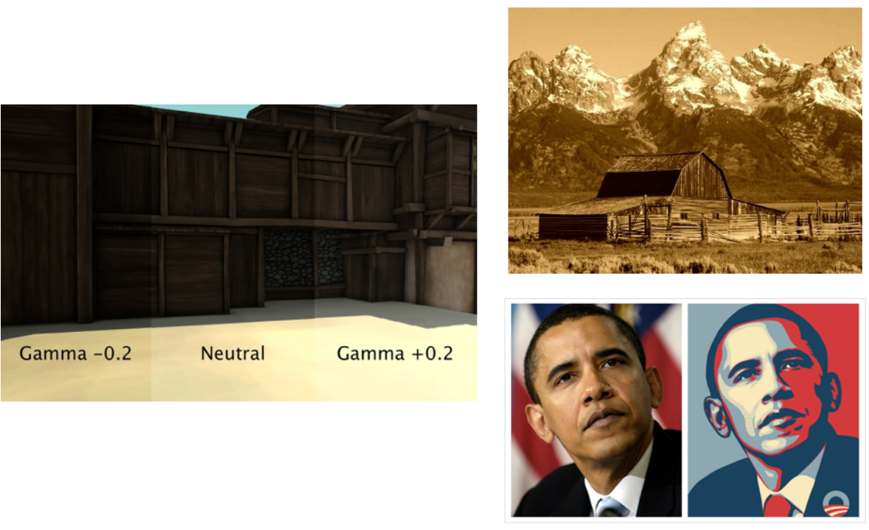
Many other types of point processing

Slide 22
Dimensionality of an Image
@ 8bit = 256 values ^ 65,536
Computer says ‘Inf’ combinations.
Some depiction of all possible scenes would fit into this memory.
Notes:
Zoran and Weiss: “In the context of this work, a natural image would be the result of taking an ordinary digital camera, pointing it somewhere in the world and pressing the shutter button.“

Slide 23
Dimensionality of an Image
@ 8bit = 256 values ^ 65,536
Computer says ‘Inf’ combinations.
Some depiction of all possible scenes would fit into this memory.
Computer vision as making sense of an extremely high-dimensional space.
Subspace of ‘natural’ images.
Deriving low-dimensional, explainable models.
Notes:
Zoran and Weiss: “In the context of this work, a natural image would be the result of taking an ordinary digital camera, pointing it somewhere in the world and pressing the shutter button.“

Slide 24

What is each part of an image?
y
x
Notes:
What is a pixel?

Slide 25
What is each part of an image?
Pixel -> picture element
‘138’
y
I(x,y)
x
Notes:
What is a pixel?

Slide 26
Image as a 2D sampling of signal
Signal: function depending on some variable with physical meaning.
Image: sampling of that function.
2 variables: xy coordinates
3 variables: xy + time (video)
‘Brightness’ is the value of the function for visible light
Can be other physical values too: temperature, pressure, depth …
Danny Alexander
Notes:
Danny Alexander, UCL

Slide 27
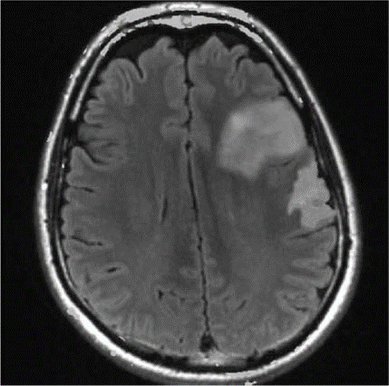
Example 2D Images
Danny Alexander
Notes:
fMRI - changes in blood flow in the brain associated with neural activity
http://radiologykey.com/wp-content/uploads/2016/01/9781604063325_c014_f004.jpg

Slide 28
Sampling in 1D
f(x)
[2,6,5,2]
x
x
Sampling in 1D takes a function and returns a vector whose elements are values of that function at the sample points.
Danny Alexander

Slide 29
Sampling in 2D
f(x)
x
y
Sampling in 2D takes a function and returns a matrix.
x
y
Danny Alexander

Slide 30
Grayscale Digital Image as ‘Height Map’
Brightness
or intensity
x
y
Danny Alexander

Slide 31
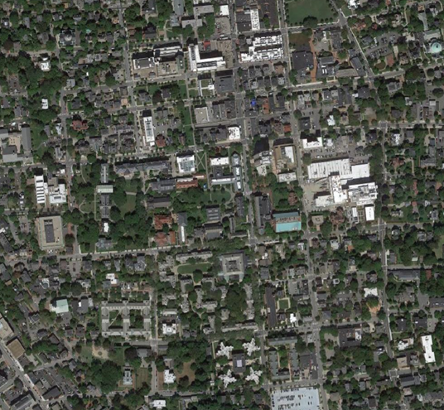
What is each part of a photograph?
Pixel -> picture element
‘127’
y
I(x,y)
x
Notes:
What is a pixel?

Slide 32


Integrating light over a range of angles.
Output Image
Camera Sensor
James Hays
Notes:
We can approximate a pixel as a square frustum - https://en.wikipedia.org/wiki/Frustum
Sometimes we approximate it as a solid angle - https://en.wikipedia.org/wiki/Solid_angle
TODO: scene element (or image plane output) should be flipped as projection optics turn image upside down.

Slide 33
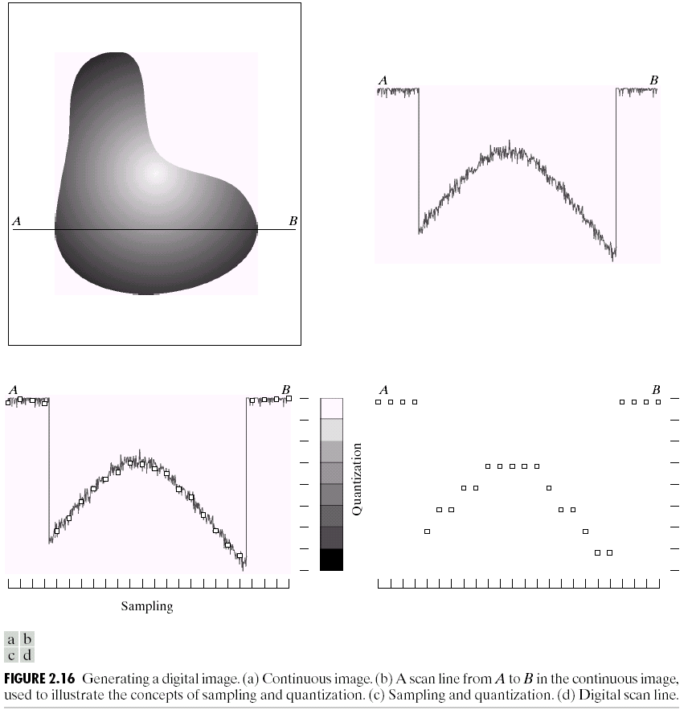
Quantization
Underlying signal
Quantized values
Notes:
Real valued function will get digital values – integer values
• Quantization is lossy!!
– After quantization, the original signal cannot be reconstructed anymore
• This is in contrast to sampling, as a sampled but not quantized signal can be reconstructed.
• Simple quantization uses equally spaced levels with k intervals
Figure 2.16 from Szeliski textbook.

Slide 34
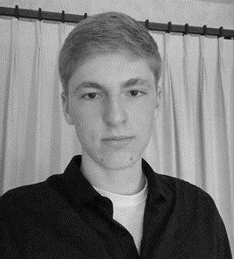
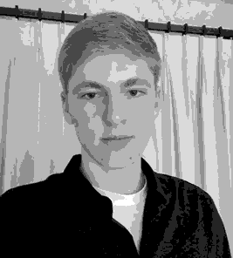


Quantization Effects – Radiometric Resolution
8 bit – 256 levels
4 bit – 16 levels
2 bit – 4 levels
1 bit – 2 levels
We often call this bit depth. For photography, this is also related to dynamic range.
Notes:
Image is of Jackson Gibbons – one of our past TAs
Dynamic range: The minimum and maximum range of light intensity that can be measured.

Slide 35
Linear shift-invariant image filtering

Slide 36
This week: three views of filtering
Image filters in spatial domain
Filter is a mathematical operation of a grid of numbers
Smoothing, sharpening, measuring texture
Image filters in the frequency domain
Filtering is a way to modify the frequencies of images
Denoising, sampling, image compression
Image pyramids
Scale-space representation allows coarse-to-fine operations
James Hays

Slide 37
Linear shift-invariant image filtering
Replace each pixel by a linear combination of its neighbors (and possibly itself).
The combination is determined by the filter’s kernel.
The same kernel is shifted to all pixel locations so that all pixels use the same linear combination of their neighbors.

Slide 38

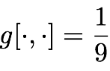
Example: the box filter
also known as the 2D rect (not rekt) filter
also known as the square mean filter
kernel
1 | 1 | 1
1 | 1 | 1
1 | 1 | 1
replaces pixel with local average
has smoothing (blurring) effect

Slide 39
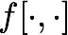
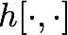
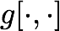
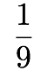
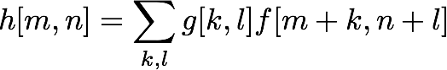
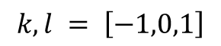
Let’s run the box filter
image
output
0 | 0 | 0 | 0 | 0 | 0 | 0 | 0 | 0 | 0
0 | 0 | 0 | 0 | 0 | 0 | 0 | 0 | 0 | 0
0 | 0 | 0 | 90 | 90 | 90 | 90 | 90 | 0 | 0
0 | 0 | 0 | 90 | 90 | 90 | 90 | 90 | 0 | 0
0 | 0 | 0 | 90 | 0 | 90 | 90 | 90 | 0 | 0
0 | 0 | 0 | 90 | 90 | 90 | 90 | 90 | 0 | 0
0 | 0 | 0 | 0 | 0 | 0 | 0 | 0 | 0 | 0
0 | 0 | 0 | 0 | 0 | 0 | 0 | 0 | 0 | 0
0 | 0 | 90 | 0 | 0 | 0 | 0 | 0 | 0 | 0
0 | 0 | 0 | 0 | 0 | 0 | 0 | 0 | 0 | 0
kernel
1 | 1 | 1
1 | 1 | 1
1 | 1 | 1
note that we assume that the kernel coordinates are centered
output
filter
image (signal)
$$k,l = \left[−1,0,1\right]$$

Slide 40
Let’s run the box filter
image
output
0 | 0 | 0 | 0 | 0 | 0 | 0 | 0 | 0 | 0
0 | 0 | 0 | 0 | 0 | 0 | 0 | 0 | 0 | 0
0 | 0 | 0 | 90 | 90 | 90 | 90 | 90 | 0 | 0
0 | 0 | 0 | 90 | 90 | 90 | 90 | 90 | 0 | 0
0 | 0 | 0 | 90 | 0 | 90 | 90 | 90 | 0 | 0
0 | 0 | 0 | 90 | 90 | 90 | 90 | 90 | 0 | 0
0 | 0 | 0 | 0 | 0 | 0 | 0 | 0 | 0 | 0
0 | 0 | 0 | 0 | 0 | 0 | 0 | 0 | 0 | 0
0 | 0 | 90 | 0 | 0 | 0 | 0 | 0 | 0 | 0
0 | 0 | 0 | 0 | 0 | 0 | 0 | 0 | 0 | 0
 | 0
kernel
1 | 1 | 1
1 | 1 | 1
1 | 1 | 1
output
filter
image (signal)

Slide 41
Let’s run the box filter
image
output
0 | 0 | 0 | 0 | 0 | 0 | 0 | 0 | 0 | 0
0 | 0 | 0 | 0 | 0 | 0 | 0 | 0 | 0 | 0
0 | 0 | 0 | 90 | 90 | 90 | 90 | 90 | 0 | 0
0 | 0 | 0 | 90 | 90 | 90 | 90 | 90 | 0 | 0
0 | 0 | 0 | 90 | 0 | 90 | 90 | 90 | 0 | 0
0 | 0 | 0 | 90 | 90 | 90 | 90 | 90 | 0 | 0
0 | 0 | 0 | 0 | 0 | 0 | 0 | 0 | 0 | 0
0 | 0 | 0 | 0 | 0 | 0 | 0 | 0 | 0 | 0
0 | 0 | 90 | 0 | 0 | 0 | 0 | 0 | 0 | 0
0 | 0 | 0 | 0 | 0 | 0 | 0 | 0 | 0 | 0
 | 0
kernel
1 | 1 | 1
1 | 1 | 1
1 | 1 | 1
shift-invariant: as the pixel shifts, so does the kernel
output
filter
image (signal)

Slide 42
Let’s run the box filter
image
output
0 | 0 | 0 | 0 | 0 | 0 | 0 | 0 | 0 | 0
0 | 0 | 0 | 0 | 0 | 0 | 0 | 0 | 0 | 0
0 | 0 | 0 | 90 | 90 | 90 | 90 | 90 | 0 | 0
0 | 0 | 0 | 90 | 90 | 90 | 90 | 90 | 0 | 0
0 | 0 | 0 | 90 | 0 | 90 | 90 | 90 | 0 | 0
0 | 0 | 0 | 90 | 90 | 90 | 90 | 90 | 0 | 0
0 | 0 | 0 | 0 | 0 | 0 | 0 | 0 | 0 | 0
0 | 0 | 0 | 0 | 0 | 0 | 0 | 0 | 0 | 0
0 | 0 | 90 | 0 | 0 | 0 | 0 | 0 | 0 | 0
0 | 0 | 0 | 0 | 0 | 0 | 0 | 0 | 0 | 0
 | 0 | 10
kernel
1 | 1 | 1
1 | 1 | 1
1 | 1 | 1
output
filter
image (signal)

Slide 43
Let’s run the box filter
image
output
0 | 0 | 0 | 0 | 0 | 0 | 0 | 0 | 0 | 0
0 | 0 | 0 | 0 | 0 | 0 | 0 | 0 | 0 | 0
0 | 0 | 0 | 90 | 90 | 90 | 90 | 90 | 0 | 0
0 | 0 | 0 | 90 | 90 | 90 | 90 | 90 | 0 | 0
0 | 0 | 0 | 90 | 0 | 90 | 90 | 90 | 0 | 0
0 | 0 | 0 | 90 | 90 | 90 | 90 | 90 | 0 | 0
0 | 0 | 0 | 0 | 0 | 0 | 0 | 0 | 0 | 0
0 | 0 | 0 | 0 | 0 | 0 | 0 | 0 | 0 | 0
0 | 0 | 90 | 0 | 0 | 0 | 0 | 0 | 0 | 0
0 | 0 | 0 | 0 | 0 | 0 | 0 | 0 | 0 | 0
 | 0 | 10
kernel
1 | 1 | 1
1 | 1 | 1
1 | 1 | 1
output
filter
image (signal)

Slide 44
Let’s run the box filter
image
output
0 | 0 | 0 | 0 | 0 | 0 | 0 | 0 | 0 | 0
0 | 0 | 0 | 0 | 0 | 0 | 0 | 0 | 0 | 0
0 | 0 | 0 | 90 | 90 | 90 | 90 | 90 | 0 | 0
0 | 0 | 0 | 90 | 90 | 90 | 90 | 90 | 0 | 0
0 | 0 | 0 | 90 | 0 | 90 | 90 | 90 | 0 | 0
0 | 0 | 0 | 90 | 90 | 90 | 90 | 90 | 0 | 0
0 | 0 | 0 | 0 | 0 | 0 | 0 | 0 | 0 | 0
0 | 0 | 0 | 0 | 0 | 0 | 0 | 0 | 0 | 0
0 | 0 | 90 | 0 | 0 | 0 | 0 | 0 | 0 | 0
0 | 0 | 0 | 0 | 0 | 0 | 0 | 0 | 0 | 0
 | 0 | 10 | 20
kernel
1 | 1 | 1
1 | 1 | 1
1 | 1 | 1
output
filter
image (signal)

Slide 45
Let’s run the box filter
image
output
0 | 0 | 0 | 0 | 0 | 0 | 0 | 0 | 0 | 0
0 | 0 | 0 | 0 | 0 | 0 | 0 | 0 | 0 | 0
0 | 0 | 0 | 90 | 90 | 90 | 90 | 90 | 0 | 0
0 | 0 | 0 | 90 | 90 | 90 | 90 | 90 | 0 | 0
0 | 0 | 0 | 90 | 0 | 90 | 90 | 90 | 0 | 0
0 | 0 | 0 | 90 | 90 | 90 | 90 | 90 | 0 | 0
0 | 0 | 0 | 0 | 0 | 0 | 0 | 0 | 0 | 0
0 | 0 | 0 | 0 | 0 | 0 | 0 | 0 | 0 | 0
0 | 0 | 90 | 0 | 0 | 0 | 0 | 0 | 0 | 0
0 | 0 | 0 | 0 | 0 | 0 | 0 | 0 | 0 | 0
 | 0 | 10 | 20
kernel
1 | 1 | 1
1 | 1 | 1
1 | 1 | 1
output
filter
image (signal)

Slide 46
Let’s run the box filter
image
output
0 | 0 | 0 | 0 | 0 | 0 | 0 | 0 | 0 | 0
0 | 0 | 0 | 0 | 0 | 0 | 0 | 0 | 0 | 0
0 | 0 | 0 | 90 | 90 | 90 | 90 | 90 | 0 | 0
0 | 0 | 0 | 90 | 90 | 90 | 90 | 90 | 0 | 0
0 | 0 | 0 | 90 | 0 | 90 | 90 | 90 | 0 | 0
0 | 0 | 0 | 90 | 90 | 90 | 90 | 90 | 0 | 0
0 | 0 | 0 | 0 | 0 | 0 | 0 | 0 | 0 | 0
0 | 0 | 0 | 0 | 0 | 0 | 0 | 0 | 0 | 0
0 | 0 | 90 | 0 | 0 | 0 | 0 | 0 | 0 | 0
0 | 0 | 0 | 0 | 0 | 0 | 0 | 0 | 0 | 0
 | 0 | 10 | 20 | 30
kernel
1 | 1 | 1
1 | 1 | 1
1 | 1 | 1
output
filter
image (signal)

Slide 47
Let’s run the box filter
image
output
0 | 0 | 0 | 0 | 0 | 0 | 0 | 0 | 0 | 0
0 | 0 | 0 | 0 | 0 | 0 | 0 | 0 | 0 | 0
0 | 0 | 0 | 90 | 90 | 90 | 90 | 90 | 0 | 0
0 | 0 | 0 | 90 | 90 | 90 | 90 | 90 | 0 | 0
0 | 0 | 0 | 90 | 0 | 90 | 90 | 90 | 0 | 0
0 | 0 | 0 | 90 | 90 | 90 | 90 | 90 | 0 | 0
0 | 0 | 0 | 0 | 0 | 0 | 0 | 0 | 0 | 0
0 | 0 | 0 | 0 | 0 | 0 | 0 | 0 | 0 | 0
0 | 0 | 90 | 0 | 0 | 0 | 0 | 0 | 0 | 0
0 | 0 | 0 | 0 | 0 | 0 | 0 | 0 | 0 | 0
 | 0 | 10 | 20 | 30 | 30
kernel
1 | 1 | 1
1 | 1 | 1
1 | 1 | 1
output
filter
image (signal)

Slide 48
Let’s run the box filter
image
output
0 | 0 | 0 | 0 | 0 | 0 | 0 | 0 | 0 | 0
0 | 0 | 0 | 0 | 0 | 0 | 0 | 0 | 0 | 0
0 | 0 | 0 | 90 | 90 | 90 | 90 | 90 | 0 | 0
0 | 0 | 0 | 90 | 90 | 90 | 90 | 90 | 0 | 0
0 | 0 | 0 | 90 | 0 | 90 | 90 | 90 | 0 | 0
0 | 0 | 0 | 90 | 90 | 90 | 90 | 90 | 0 | 0
0 | 0 | 0 | 0 | 0 | 0 | 0 | 0 | 0 | 0
0 | 0 | 0 | 0 | 0 | 0 | 0 | 0 | 0 | 0
0 | 0 | 90 | 0 | 0 | 0 | 0 | 0 | 0 | 0
0 | 0 | 0 | 0 | 0 | 0 | 0 | 0 | 0 | 0
 | 0 | 10 | 20 | 30 | 30 | 30
kernel
1 | 1 | 1
1 | 1 | 1
1 | 1 | 1
output
filter
image (signal)

Slide 49
Let’s run the box filter
image
output
0 | 0 | 0 | 0 | 0 | 0 | 0 | 0 | 0 | 0
0 | 0 | 0 | 0 | 0 | 0 | 0 | 0 | 0 | 0
0 | 0 | 0 | 90 | 90 | 90 | 90 | 90 | 0 | 0
0 | 0 | 0 | 90 | 90 | 90 | 90 | 90 | 0 | 0
0 | 0 | 0 | 90 | 0 | 90 | 90 | 90 | 0 | 0
0 | 0 | 0 | 90 | 90 | 90 | 90 | 90 | 0 | 0
0 | 0 | 0 | 0 | 0 | 0 | 0 | 0 | 0 | 0
0 | 0 | 0 | 0 | 0 | 0 | 0 | 0 | 0 | 0
0 | 0 | 90 | 0 | 0 | 0 | 0 | 0 | 0 | 0
0 | 0 | 0 | 0 | 0 | 0 | 0 | 0 | 0 | 0
 | 0 | 10 | 20 | 30 | 30 | 30 | 20
kernel
1 | 1 | 1
1 | 1 | 1
1 | 1 | 1
output
filter
image (signal)

Slide 50
Let’s run the box filter
image
output
0 | 0 | 0 | 0 | 0 | 0 | 0 | 0 | 0 | 0
0 | 0 | 0 | 0 | 0 | 0 | 0 | 0 | 0 | 0
0 | 0 | 0 | 90 | 90 | 90 | 90 | 90 | 0 | 0
0 | 0 | 0 | 90 | 90 | 90 | 90 | 90 | 0 | 0
0 | 0 | 0 | 90 | 0 | 90 | 90 | 90 | 0 | 0
0 | 0 | 0 | 90 | 90 | 90 | 90 | 90 | 0 | 0
0 | 0 | 0 | 0 | 0 | 0 | 0 | 0 | 0 | 0
0 | 0 | 0 | 0 | 0 | 0 | 0 | 0 | 0 | 0
0 | 0 | 90 | 0 | 0 | 0 | 0 | 0 | 0 | 0
0 | 0 | 0 | 0 | 0 | 0 | 0 | 0 | 0 | 0
 | 0 | 10 | 20 | 30 | 30 | 30 | 20 | 10
kernel
1 | 1 | 1
1 | 1 | 1
1 | 1 | 1
output
filter
image (signal)

Slide 51
Let’s run the box filter
image
output
0 | 0 | 0 | 0 | 0 | 0 | 0 | 0 | 0 | 0
0 | 0 | 0 | 0 | 0 | 0 | 0 | 0 | 0 | 0
0 | 0 | 0 | 90 | 90 | 90 | 90 | 90 | 0 | 0
0 | 0 | 0 | 90 | 90 | 90 | 90 | 90 | 0 | 0
0 | 0 | 0 | 90 | 0 | 90 | 90 | 90 | 0 | 0
0 | 0 | 0 | 90 | 90 | 90 | 90 | 90 | 0 | 0
0 | 0 | 0 | 0 | 0 | 0 | 0 | 0 | 0 | 0
0 | 0 | 0 | 0 | 0 | 0 | 0 | 0 | 0 | 0
0 | 0 | 90 | 0 | 0 | 0 | 0 | 0 | 0 | 0
0 | 0 | 0 | 0 | 0 | 0 | 0 | 0 | 0 | 0
 | 0 | 10 | 20 | 30 | 30 | 30 | 20 | 10
 | 0
kernel
1 | 1 | 1
1 | 1 | 1
1 | 1 | 1
output
filter
image (signal)

Slide 52
Let’s run the box filter
image
output
0 | 0 | 0 | 0 | 0 | 0 | 0 | 0 | 0 | 0
0 | 0 | 0 | 0 | 0 | 0 | 0 | 0 | 0 | 0
0 | 0 | 0 | 90 | 90 | 90 | 90 | 90 | 0 | 0
0 | 0 | 0 | 90 | 90 | 90 | 90 | 90 | 0 | 0
0 | 0 | 0 | 90 | 0 | 90 | 90 | 90 | 0 | 0
0 | 0 | 0 | 90 | 90 | 90 | 90 | 90 | 0 | 0
0 | 0 | 0 | 0 | 0 | 0 | 0 | 0 | 0 | 0
0 | 0 | 0 | 0 | 0 | 0 | 0 | 0 | 0 | 0
0 | 0 | 90 | 0 | 0 | 0 | 0 | 0 | 0 | 0
0 | 0 | 0 | 0 | 0 | 0 | 0 | 0 | 0 | 0
 | 0 | 10 | 20 | 30 | 30 | 30 | 20 | 10
 | 0 | 20
kernel
1 | 1 | 1
1 | 1 | 1
1 | 1 | 1
output
filter
image (signal)

Slide 53
Let’s run the box filter
image
output
0 | 0 | 0 | 0 | 0 | 0 | 0 | 0 | 0 | 0
0 | 0 | 0 | 0 | 0 | 0 | 0 | 0 | 0 | 0
0 | 0 | 0 | 90 | 90 | 90 | 90 | 90 | 0 | 0
0 | 0 | 0 | 90 | 90 | 90 | 90 | 90 | 0 | 0
0 | 0 | 0 | 90 | 0 | 90 | 90 | 90 | 0 | 0
0 | 0 | 0 | 90 | 90 | 90 | 90 | 90 | 0 | 0
0 | 0 | 0 | 0 | 0 | 0 | 0 | 0 | 0 | 0
0 | 0 | 0 | 0 | 0 | 0 | 0 | 0 | 0 | 0
0 | 0 | 90 | 0 | 0 | 0 | 0 | 0 | 0 | 0
0 | 0 | 0 | 0 | 0 | 0 | 0 | 0 | 0 | 0
 | 0 | 10 | 20 | 30 | 30 | 30 | 20 | 10
 | 0 | 20 | 40
kernel
1 | 1 | 1
1 | 1 | 1
1 | 1 | 1
output
filter
image (signal)

Slide 54
Let’s run the box filter
image
output
0 | 0 | 0 | 0 | 0 | 0 | 0 | 0 | 0 | 0
0 | 0 | 0 | 0 | 0 | 0 | 0 | 0 | 0 | 0
0 | 0 | 0 | 90 | 90 | 90 | 90 | 90 | 0 | 0
0 | 0 | 0 | 90 | 90 | 90 | 90 | 90 | 0 | 0
0 | 0 | 0 | 90 | 0 | 90 | 90 | 90 | 0 | 0
0 | 0 | 0 | 90 | 90 | 90 | 90 | 90 | 0 | 0
0 | 0 | 0 | 0 | 0 | 0 | 0 | 0 | 0 | 0
0 | 0 | 0 | 0 | 0 | 0 | 0 | 0 | 0 | 0
0 | 0 | 90 | 0 | 0 | 0 | 0 | 0 | 0 | 0
0 | 0 | 0 | 0 | 0 | 0 | 0 | 0 | 0 | 0
 | 0 | 10 | 20 | 30 | 30 | 30 | 20 | 10
 | 0 | 20 | 40 | 60 | 60 | 60 | 40 | 20
 | 0
kernel
1 | 1 | 1
1 | 1 | 1
1 | 1 | 1
output
filter
image (signal)

Slide 55
Let’s run the box filter
image
output
0 | 0 | 0 | 0 | 0 | 0 | 0 | 0 | 0 | 0
0 | 0 | 0 | 0 | 0 | 0 | 0 | 0 | 0 | 0
0 | 0 | 0 | 90 | 90 | 90 | 90 | 90 | 0 | 0
0 | 0 | 0 | 90 | 90 | 90 | 90 | 90 | 0 | 0
0 | 0 | 0 | 90 | 0 | 90 | 90 | 90 | 0 | 0
0 | 0 | 0 | 90 | 90 | 90 | 90 | 90 | 0 | 0
0 | 0 | 0 | 0 | 0 | 0 | 0 | 0 | 0 | 0
0 | 0 | 0 | 0 | 0 | 0 | 0 | 0 | 0 | 0
0 | 0 | 90 | 0 | 0 | 0 | 0 | 0 | 0 | 0
0 | 0 | 0 | 0 | 0 | 0 | 0 | 0 | 0 | 0
 | 0 | 10 | 20 | 30 | 30 | 30 | 20 | 10
 | 0 | 20 | 40 | 60 | 60 | 60 | 40 | 20
 | 0 | 30
kernel
1 | 1 | 1
1 | 1 | 1
1 | 1 | 1
output
filter
image (signal)

Slide 56
Let’s run the box filter
image
output
0 | 0 | 0 | 0 | 0 | 0 | 0 | 0 | 0 | 0
0 | 0 | 0 | 0 | 0 | 0 | 0 | 0 | 0 | 0
0 | 0 | 0 | 90 | 90 | 90 | 90 | 90 | 0 | 0
0 | 0 | 0 | 90 | 90 | 90 | 90 | 90 | 0 | 0
0 | 0 | 0 | 90 | 0 | 90 | 90 | 90 | 0 | 0
0 | 0 | 0 | 90 | 90 | 90 | 90 | 90 | 0 | 0
0 | 0 | 0 | 0 | 0 | 0 | 0 | 0 | 0 | 0
0 | 0 | 0 | 0 | 0 | 0 | 0 | 0 | 0 | 0
0 | 0 | 90 | 0 | 0 | 0 | 0 | 0 | 0 | 0
0 | 0 | 0 | 0 | 0 | 0 | 0 | 0 | 0 | 0
 | 0 | 10 | 20 | 30 | 30 | 30 | 20 | 10
 | 0 | 20 | 40 | 60 | 60 | 60 | 40 | 20
 | 0 | 30 | 50 | 80 | 80 | 90 | 60 | 30
 | 0 | 30 | 50 | 80 | 80 | 90 | 60 | 30
 | 0 | 20 | 30 | 50 | 50 | 60 | 40 | 20
 | 0 | 10 | 20 | 30 | 30 | 30 | 20 | 10
 | 10 | 10 | 10 | 10 | 0 | 0 | 0 | 0
 | 10
kernel
1 | 1 | 1
1 | 1 | 1
1 | 1 | 1
output
filter
image (signal)

Slide 57
Let’s run the box filter
image
output
0 | 0 | 0 | 0 | 0 | 0 | 0 | 0 | 0 | 0
0 | 0 | 0 | 0 | 0 | 0 | 0 | 0 | 0 | 0
0 | 0 | 0 | 90 | 90 | 90 | 90 | 90 | 0 | 0
0 | 0 | 0 | 90 | 90 | 90 | 90 | 90 | 0 | 0
0 | 0 | 0 | 90 | 0 | 90 | 90 | 90 | 0 | 0
0 | 0 | 0 | 90 | 90 | 90 | 90 | 90 | 0 | 0
0 | 0 | 0 | 0 | 0 | 0 | 0 | 0 | 0 | 0
0 | 0 | 0 | 0 | 0 | 0 | 0 | 0 | 0 | 0
0 | 0 | 90 | 0 | 0 | 0 | 0 | 0 | 0 | 0
0 | 0 | 0 | 0 | 0 | 0 | 0 | 0 | 0 | 0
 | 0 | 10 | 20 | 30 | 30 | 30 | 20 | 10
 | 0 | 20 | 40 | 60 | 60 | 60 | 40 | 20
 | 0 | 30 | 50 | 80 | 80 | 90 | 60 | 30
 | 0 | 30 | 50 | 80 | 80 | 90 | 60 | 30
 | 0 | 20 | 30 | 50 | 50 | 60 | 40 | 20
 | 0 | 10 | 20 | 30 | 30 | 30 | 20 | 10
 | 10 | 10 | 10 | 10 | 0 | 0 | 0 | 0
 | 10 | 10 | 10 | 10 | 0 | 0 | 0 | 0
kernel
1 | 1 | 1
1 | 1 | 1
1 | 1 | 1
output
filter
image (signal)

Slide 58
… and the result is
image
output
0 | 0 | 0 | 0 | 0 | 0 | 0 | 0 | 0 | 0
0 | 0 | 0 | 0 | 0 | 0 | 0 | 0 | 0 | 0
0 | 0 | 0 | 90 | 90 | 90 | 90 | 90 | 0 | 0
0 | 0 | 0 | 90 | 90 | 90 | 90 | 90 | 0 | 0
0 | 0 | 0 | 90 | 0 | 90 | 90 | 90 | 0 | 0
0 | 0 | 0 | 90 | 90 | 90 | 90 | 90 | 0 | 0
0 | 0 | 0 | 0 | 0 | 0 | 0 | 0 | 0 | 0
0 | 0 | 0 | 0 | 0 | 0 | 0 | 0 | 0 | 0
0 | 0 | 90 | 0 | 0 | 0 | 0 | 0 | 0 | 0
0 | 0 | 0 | 0 | 0 | 0 | 0 | 0 | 0 | 0
 | 0 | 10 | 20 | 30 | 30 | 30 | 20 | 10
 | 0 | 20 | 40 | 60 | 60 | 60 | 40 | 20
 | 0 | 30 | 50 | 80 | 80 | 90 | 60 | 30
 | 0 | 30 | 50 | 80 | 80 | 90 | 60 | 30
 | 0 | 20 | 30 | 50 | 50 | 60 | 40 | 20
 | 0 | 10 | 20 | 30 | 30 | 30 | 20 | 10
 | 10 | 10 | 10 | 10 | 0 | 0 | 0 | 0
 | 10 | 10 | 10 | 10 | 0 | 0 | 0 | 0
kernel
1 | 1 | 1
1 | 1 | 1
1 | 1 | 1
output
filter
image (signal)

Slide 59
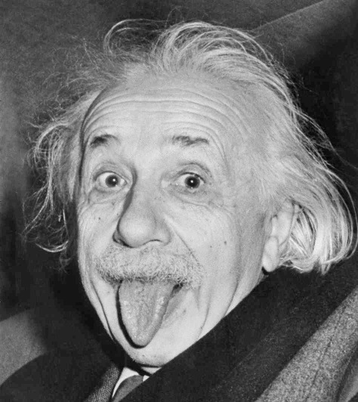

Some more realistic examples

Slide 60
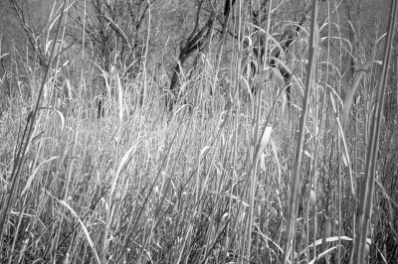

Some more realistic examples

Slide 61
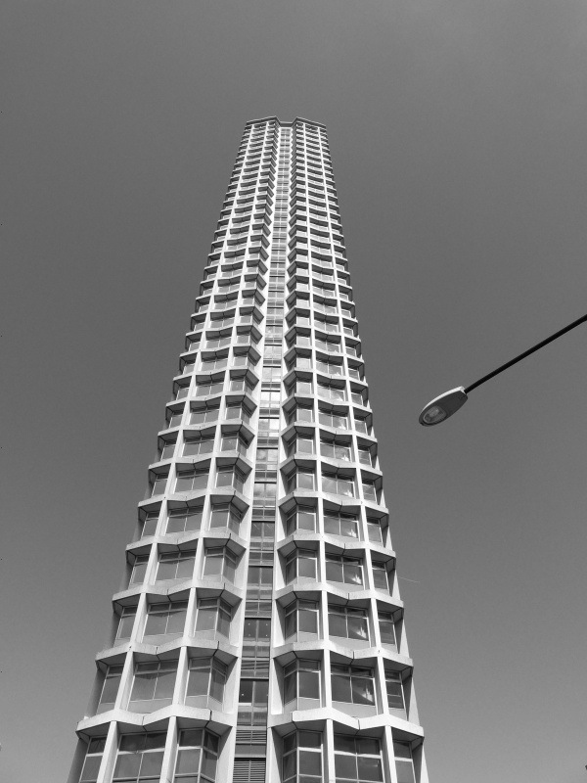
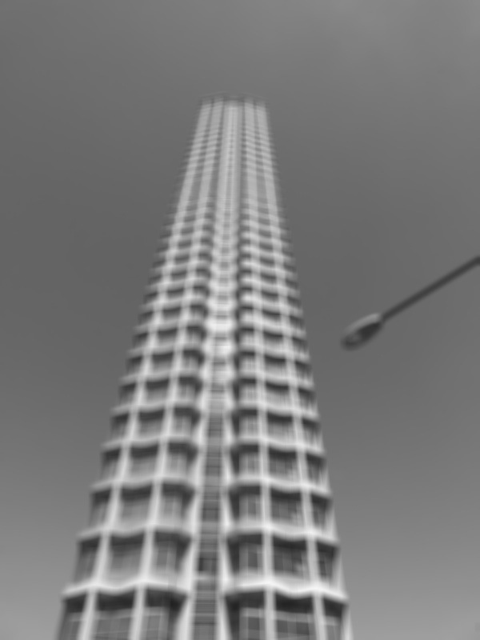
Some more realistic examples

Slide 62
Image filtering
Compute function of local neighborhood at each position:
James Hays

Slide 63
Image filtering
Compute function of local neighborhood at each position:
h=output
f=filter
I=image
2d coords=k,l
2d coords=m,n
[ ]
[ ]
[ ]

Slide 64

Box Filter
What does it do?
Replaces each pixel with an average of its neighborhood
Achieve smoothing effect (remove ‘sharp’ features)
1
1
1
1
1
1
1
1
1
Slide credit: David Lowe (UBC)

Slide 65
Box Filter
What does it do?
Replaces each pixel with an average of its neighborhood
Achieve smoothing effect (remove ‘sharp’ features)
Why does it sum to one?
1
1
1
1
1
1
1
1
1
Slide credit: David Lowe (UBC)

Slide 66
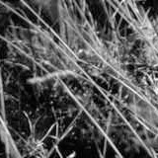
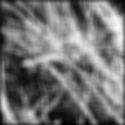
Smoothing with box filter
David Lowe
1
1
1
1
1
1
1
1
1

Slide 67
Image filtering
Compute function of local neighborhood
at each position:
Really important!
Enhance images
Denoise, resize, increase contrast, etc.
Extract information from images
Texture, edges, distinctive points, etc.
Detect patterns
Template matching
James Hays

Slide 68
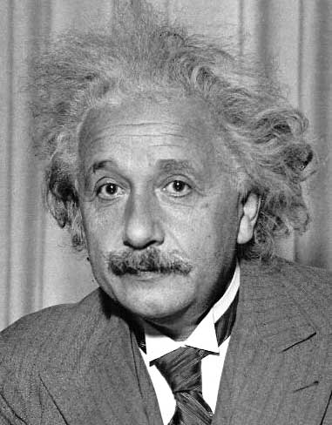
Filtering practice

Slide 69
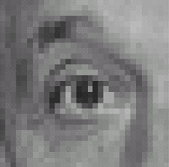

0
0
0
1.
0
1
0
0
0
0
0
0
0
2.
0
0
1
0
0
0
1
0
-1
3.
2
0
-2
1
0
-1
0
0
0
-
1
1
1
4.
0
2
0
1
1
1
0
0
0
1
1
1

Slide 70
1. Practice with linear filters
0
0
0
?
0
1
0
0
0
0
Original
Source: D. Lowe

Slide 71
1. Practice with linear filters
0
0
0
0
1
0
0
0
0
Original
Filtered
(no change)
Source: D. Lowe

Slide 72
2. Practice with linear filters
0
0
0
?
0
0
1
0
0
0
Original
Source: D. Lowe

Slide 73
2. Practice with linear filters
0
0
0
0
0
1
0
0
0
Original
Shifted left
By 1 pixel
Source: D. Lowe

Slide 74
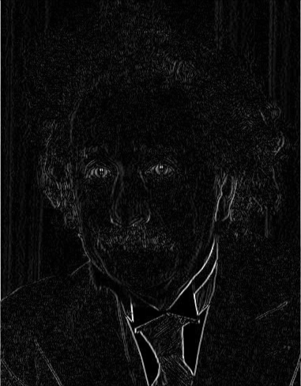
3. Practice with linear filters
1
0
-1
2
0
-2
1
0
-1
Sobel
Vertical Edge
(absolute value)
David Lowe

Slide 75
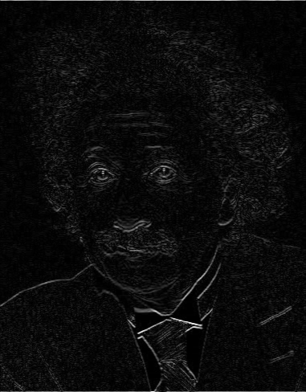
3. Practice with linear filters
1
2
1
0
0
0
-1
-2
-1
Sobel
Horizontal Edge
(absolute value)
David Lowe
Notes:
Questions at this point?

Slide 76
4. Practice with linear filters
0
0
0
-
1
1
1
?
0
2
0
1
1
1
0
0
0
1
1
1
(Note that filter sums to 1)
Original
Source: D. Lowe

Slide 77
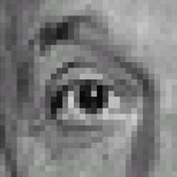
4. Practice with linear filters
0
0
0
-
1
1
1
0
2
0
1
1
1
0
0
0
1
1
1
Original
Sharpening filter
Accentuates differences with local average
Source: D. Lowe

Slide 78
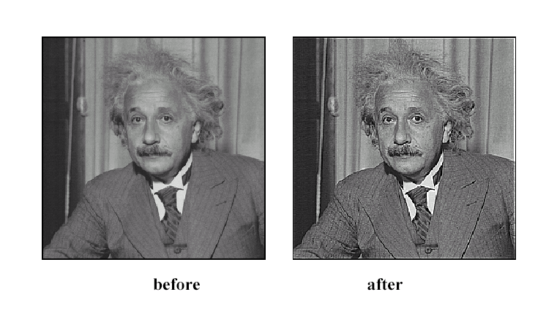
4. Practice with linear filters
Source: D. Lowe

Slide 79

Sharpening examples

Slide 80
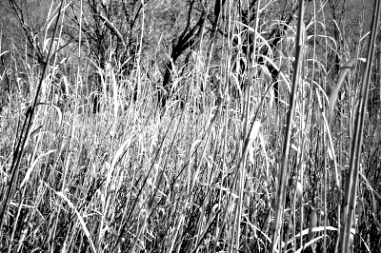
Sharpening examples

Slide 81
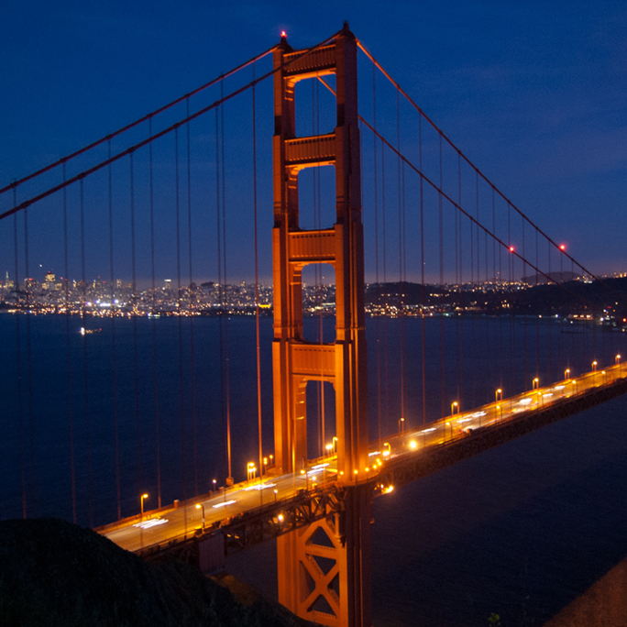
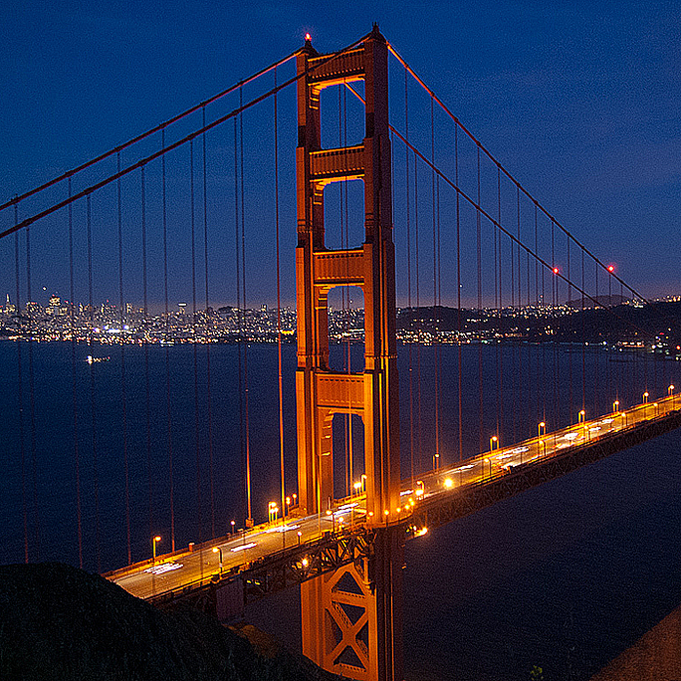
Sharpening examples

Slide 82
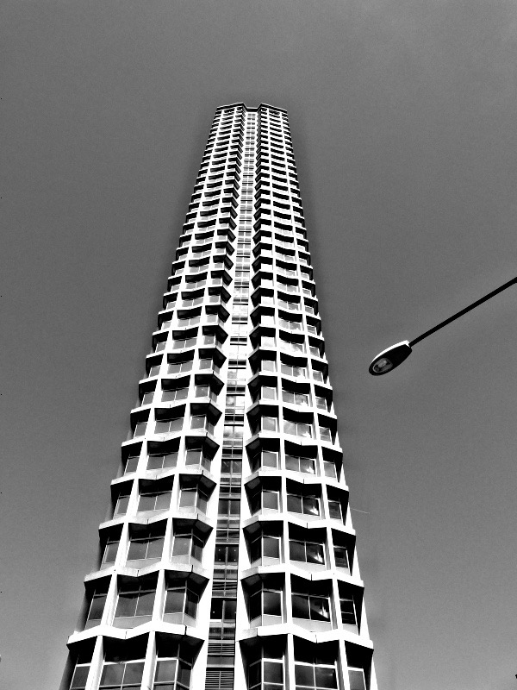
Sharpening examples
do you see any problems in this image?

Slide 83
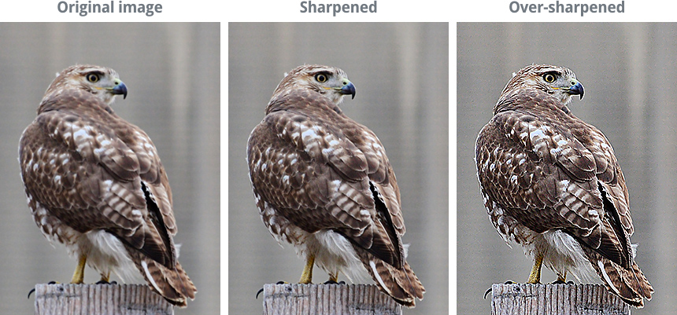
Do not overdo it with sharpening
original
sharpened
oversharpened
What is wrong in this image?

Slide 84
Convolution

Slide 85
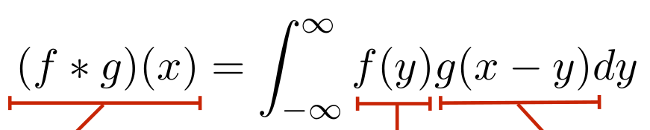
Convolution for 1D continuous signals
Definition of filtering as convolution:
notice the flip
filtered signal
filter
input signal

Slide 86



Convolution for 1D continuous signals
Definition of filtering as convolution:
notice the flip
filtered signal
filter
input signal
Consider the box filter example:
1D continuous box filter
filtering output is a blurred version of g

Slide 87

Convolution for 2D discrete signals
Definition of filtering as convolution:
notice the flip
filtered image
filter
input image

Slide 88



Convolution for 2D discrete signals
Definition of filtering as convolution:
notice the flip
filtered image
filter
input image
If the filter is non-zero only within , then
The kernel we saw earlier is the 3x3 matrix representation of .

Slide 89
Convolution vs correlation
Definition of discrete 2D convolution:
notice the flip
Definition of discrete 2D correlation:
notice the lack of a flip
Most of the time won’t matter, because our kernels will be symmetric.
Will be important when we discuss frequency-domain filtering (lectures 5-6).

Slide 90
Separable filters
A 2D filter is separable if it can be written as the product of a “column” and a “row”.
1 | 1 | 1
1 | 1 | 1
1 | 1 | 1
1
1
1
1 | 1 | 1
example: box filter
=
*
row
column
What is the rank of this filter matrix?

Slide 91
Separable filters
A 2D filter is separable if it can be written as the product of a “column” and a “row”.
1 | 1 | 1
1 | 1 | 1
1 | 1 | 1
1
1
1
1 | 1 | 1
example: box filter
=
*
row
column
Why is this important?

Slide 92
Separable filters
A 2D filter is separable if it can be written as the product of a “column” and a “row”.
1 | 1 | 1
1 | 1 | 1
1 | 1 | 1
1
1
1
1 | 1 | 1
example: box filter
=
*
row
column
2D convolution with a separable filter is equivalent to two 1D convolutions (with the “column” and “row” filters).

Slide 93
Separable filters
A 2D filter is separable if it can be written as the product of a “column” and a “row”.
1 | 1 | 1
1 | 1 | 1
1 | 1 | 1
1
1
1
1 | 1 | 1
example: box filter
=
*
row
column
2D convolution with a separable filter is equivalent to two 1D convolutions (with the “column” and “row” filters).
If the image has M x M pixels and the filter kernel has size N x N:
What is the cost of convolution with a non-separable filter?

Slide 94
Separable filters
A 2D filter is separable if it can be written as the product of a “column” and a “row”.
1 | 1 | 1
1 | 1 | 1
1 | 1 | 1
1
1
1
1 | 1 | 1
example: box filter
=
*
row
column
2D convolution with a separable filter is equivalent to two 1D convolutions (with the “column” and “row” filters).
If the image has M x M pixels and the filter kernel has size N x N:
What is the cost of convolution with a non-separable filter? M² x N²
What is the cost of convolution with a separable filter?

Slide 95
Separable filters
A 2D filter is separable if it can be written as the product of a “column” and a “row”.
1 | 1 | 1
1 | 1 | 1
1 | 1 | 1
1
1
1
1 | 1 | 1
example: box filter
=
*
row
column
2D convolution with a separable filter is equivalent to two 1D convolutions (with the “column” and “row” filters).
If the image has M x M pixels and the filter kernel has size N x N:
What is the cost of convolution with a non-separable filter? M² x N²
What is the cost of convolution with a separable filter? 2 x N x M²

Slide 96
A few more filters
do you see any problems in this image?
original
3x3 box filter

Slide 97


The Gaussian filter
named (like many other things) after Carl Friedrich Gauss
kernel values sampled from the 2D Gaussian function:
weight falls off with distance from center pixel
theoretically infinite, in practice truncated to some maximum distance
Any heuristics for selecting where to truncate?

Slide 98
The Gaussian filter
named (like many other things) after Carl Friedrich Gauss
kernel values sampled from the 2D Gaussian function:
Is this a separable filter?
weight falls off with distance from center pixel
theoretically infinite, in practice truncated to some maximum distance
Any heuristics for selecting where to truncate?
usually at 2-3σ
1 | 2 | 1
2 | 4 | 2
1 | 2 | 1
kernel
1
16

Slide 99
The Gaussian filter
named (like many other things) after Carl Friedrich Gauss
kernel values sampled from the 2D Gaussian function:
Is this a separable filter? Yes!
weight falls off with distance from center pixel
theoretically infinite, in practice truncated to some maximum distance
Any heuristics for selecting where to truncate?
usually at 2-3σ
1 | 2 | 1
2 | 4 | 2
1 | 2 | 1
kernel
1
16

Slide 100

Gaussian filtering example

Slide 101






Gaussian vs box filtering
7x7 Gaussian
original
Which blur do you like better?
7x7 box

Slide 102
Correlation and Convolution
2d correlation
e.g., h = scipy.signal.correlate2d(f,I)
James Hays

Slide 103
Correlation and Convolution
2d correlation
2d convolution
e.g., h = scipy.signal.correlate2d(f,I)
e.g., h = scipy.signal.convolve2d(f,I)
Convolution is the same as correlation with a 180° rotated filter kernel.
Correlation and convolution are identical when the filter kernel is symmetric.
* Symmetric in the geometric sense, not in the matrix linear algebra sense.
James Hays
Notes:
Symmetric in the geometric sense, not in the linear algebra/matrix sense.
Symmetric in the matrix sense: a symmetric matrix is a square matrix that is equal to its transpose. A = A^T
I.E., matrix can be reflected along its diagonal and it is equal to itself
However, to rotate the matrix by 180 degrees and still have the same matrix, we need the matrix to also have the same values elsewhere, e.g., at the top left and bottom right.
From George Chu (2020 student):
image matrix I: 1 2
3 4
symmetric filter: 1 2 <- this matrix is equal to its transpose, but is not rotationally symmetric
2 4
Correlation computation: 1*1+2*2+3*2+4*4 = 27
Convolution computation: 1*4+2*2+3*2+4*1 = 18 <- correlation and convolution produce different answers
Rotationally symmetric: 1 2
2 1 <- this produces the same values with either correlation or convolution

Slide 104
Key properties of linear filters
Linearity:
imfilter(I, f₁ + f₂) =
imfilter(I,f₁) + imfilter(I,f₂)
Shift invariance: Same behavior given intensities regardless of pixel location m,n
imfilter(I,shift(f)) = shift(imfilter(I,f))
Any linear, shift-invariant operator can be represented as a convolution.
S. Lazebnik
Notes:
f is image

Slide 105
Convolution properties
Commutative: a * b = b * a
Conceptually no difference between filter and signal
But filtering implementations might break this equality, e.g., image edges
Associative: a * (b * c) = (a * b) * c
Often apply several filters one after another: (((a * b₁) * b₂) * b₃)
This is equivalent to applying one filter: a * (b₁ * b₂ * b₃)
Why important?
Correlation is _not_ associative (rotation effect)
Distributes over addition: a * (b + c) = (a * b) + (a * c)
Scalars factor out: ka * b = a * kb = k (a * b)
Identity: unit impulse e = [0, 0, 1, 0, 0], a * e = a
Source: S. Lazebnik
Notes:
David Jacobs @ UMD http://www.cs.umd.edu/~djacobs/CMSC426/Convolution.pdf
The key difference between the two is that convolution is associative. That is, if F and G are filters, then F*(G*I) = (F*G)*I. If you don’t believe this, try a simple example, using F=G=(-1 0 1), for example. It is very convenient to have convolution be associative. Suppose, for example, we want to smooth an image and then take its derivative. We could do this by convolving the image with a Gaussian filter, and then convolving it with a derivative filter. But we could alternatively convolve the derivative filter with the Gaussian to produce a filter called a Difference of Gaussian (DOG), and then convolve this with our image. The nice thing about this is that the DOG filter can be precomputed, and we only have to convolve one filter with our image.
In general, people use convolution for image processing operations such as smoothing, and they use correlation to match a template to an image. Then, we don’t mind that correlation isn’t associative, because it doesn’t really make sense to combine two templates into one with correlation, whereas we might often want to combine two filter together for convolution. When discussing the Fourier series as a way of understanding filtering, we will use convolution, so that we can introduce the famous convolution theorem.

Slide 106


Important filter: Gaussian
Weight contributions of neighboring pixels by nearness
x
0.003 0.013 0.022 0.013 0.003
0.013 0.059 0.097 0.059 0.013
0.022 0.097 0.159 0.097 0.022
0.013 0.059 0.097 0.059 0.013
0.003 0.013 0.022 0.013 0.003
y
x
Kernel size 5 x 5,
Standard deviation σ = 1
y
Viewed from top
y
x
Slide credit: Christopher Rasmussen
Notes:
e^0 = 1, e^-1 = .37, e^-2 = .14, etc.
Point out that x and y span from -2,-1, 0, 1, 2
Gaussian pdfs have infinite extent. Gaussian filters are discrete finite samplings of the Gaussian pdf. What that means is that the filter can be arbitrarily large, and it will never be zero (to numerical precision).

Slide 107

Smoothing with Gaussian filter
James Hays

Slide 108
Smoothing with box filter
James Hays

Slide 109
Gaussian filters
Gaussian convolved with Gaussian… …is another Gaussian
So can smooth with small-width kernel, repeat, and get same result as larger-width kernel
Convolving twice with Gaussian kernel of width σ is same as convolving once with kernel of width σ√2
Separable kernel
Factors into product of two 1D Gaussians
Source: K. Grauman
Notes:
Gaussians remove “high-frequency” components from the image (low-pass filter)
But we need to talk about image frequency first…

Slide 110

Separability of the Gaussian filter
Source: D. Lowe

Slide 111



Separability example
2D convolution (center location only)
=
The filter factors into a product of 1D filters:
Perform convolution along rows:
*
=
Followed by convolution along the remaining column:
*
=
Source: K. Grauman
Notes:
Convolution vs filtering doesn’t matter here because the filter is symmetric
9 multiply-add operations at the top for 2D convolution
~11 multiply-add operations at the bottom for the separable 2D convolution

Slide 112
Separability
Why is separability useful in practice?
MxN image, PxQ filter
2D convolution: ~MNPQ multiply-adds
Separable 2D: ~MN(P+Q) multiply-adds
Speed up = PQ/(P+Q)
9x9 filter = ~4.5x faster
Notes:
https://blogs.mathworks.com/steve/2006/10/04/separable-convolution/

Slide 113
Practical matters
How big should the filter be?
Values at edges should be near zero
Gaussians have infinite extent…
Rule of thumb for Gaussian: set filter half-width to about 3 σ
James Hays

Slide 114













Practical matters
What about near the edge?
The filter window falls off the edge of the image
Need to extrapolate
methods:
clip filter (black)
wrap around
copy edge
reflect across edge
Source: S. Marschner

Slide 115
Convolution in Convolutional Neural Networks
Convolution is the basic operation in CNNs
Learning convolution kernels allows us to learn which `features’ provide useful information in images.

Slide 116

Ben Thomas
Notes:
http://benthomas.net.au/cityshrinker/eilz24txaul9s1hx5prqr0ta5y8nvl
Somerset house in London, next to Waterloo Bridge. My undergraduate alma mater --- King’s College London --- is just on the left there.
What do you notice about this image?

Slide 117




Tilt-shift photography
Notes:
http://twistedsifter.com/2009/11/what-is-tilt-shift-photography/
https://www.google.com/url?sa=i&rct=j&q=&esrc=s&source=images&cd=&cad=rja&uact=8&ved=0ahUKEwjh0vHWnOrRAhXHNiYKHU9_C8MQjB0IBg&url=http%3A%2F%2Fwww.tiltshiftphotography.net%2Ftilt-shift-photography-examples%2F&bvm=bv.145822982,d.amc&psig=AFQjCNHwu3AEwcnsTWQDqGS8vA2-H9QSEw&ust=1485877855629030
“All of these are real scenes shot in a ‘tilt-shift style’”
Fourth one is actually a toy
Point out the fact that there is a very thin region of the world that is in focus, that the top and bottom are blurred.

Slide 118


Tilt shift camera
Sensor
Shift
Tilt
Sensor
Notes:
http://www.bobatkins.com/photography/reviews/macro_tilt_adapter/tilt.jpg

Slide 119

Macro photography
Notes:
http://cow.mooh.org/projects/tiltshift/howdoesitwork.html#miniaturisationeffectfig

Slide 120
Can we fake tilt shift?
We need to blur the image
OK, now we know how to do that.

Slide 121
Can we fake tilt shift?
We need to blur the image
OK, now we know how to do that.
We need to blur progressively more away from our ‘fake’ focal point

Slide 122

But can I make it look more like a toy?
Boost saturation – toys are very colorful
We’ll learn how to do this when we discuss color
Notes:
For now: transform to Hue, Saturation, Value instead of RGB

Slide 123
Sobel filter visualization
What happens to negative numbers?
For visualization:
Shift image + 0.5
If gradients are small, scale edge response
Notes:
- Look at a second filter which is an ‘edge detection’ filter
Negative numbers
Oh. Well, let’s take the absolute value (the magnitude)
Add the mean

Slide 124



1
2
1
>> I = img_to_float32( io.imread( ‘luke.jpg’ ) );
>> h = convolve2d( I, sobelKernel );
0
0
0
-1
-2
-1
Sobel
plt.imshow( h );
plt.imshow( h + 0.5 );
Notes:
Picture is of Luke Murray, another former TA (now an MIT PhD)

Slide 125


h(:,:,1) < 0
h(:,:,1) > 0

Slide 126









Think-Pair-Share
* = Convolution operator
1) _ = D * B
2) A = _ * _
3) F = D * _
4) _ = D * D
D
H
F
I
A
B
C
G
E
Hoiem
Notes:
1) G = D * B
2) A = B * C
3) F = D * E
4) I = D * D

Slide 127
I = D * D
D (275 x 175 pixels)
I (from slide – 275 x 175)
“…something to do with lack of content (black) at edges…”
Notes:
A student is likely to say something like the quote on the slide – build upon it for explanation.

Slide 128

I = D * D
D (275 x 175 pixels)
I (from slide – 275 x 175)
>> D = img_to_float32( io.imread( ‘convexample.png’ ) )
>> I = convolve2d( D, D )
>> np.max(I)
1.1021e+04
# Normalize for visualization >> I_norm = (I – np.min(I)) / (np.max(I) – np.min(I))
>> plt.imshow( I_norm )
I_norm

Slide 129

I = D * D
D (275 x 175 pixels)
I (from slide – 275 x 175)
(275-1)/2
(275-1)/2
(549 x 349 pixels)
I_norm
275
For x: 275 + (275-1)/2 + (275-1)/2 = 549

Slide 130

I = D * D
D (275 x 175 pixels)
I (from slide – 275 x 175)
>> I = convolve2d( D, D, mode=‘full’ )
(Default; pad with zeros)
>> I = convolve2d( D, D, mode=‘same’ )
(Return same size as D)
>> I = convolve2d( D, D, mode=‘valid’ )
(No padding)
549 x 349
275 x 175
Value = 10528.3
1x1

Slide 131
A = B * C - “because it kind of looks like it.”
A
B
C
C is a Gaussian filter (or something close to it it), and we know that it ‘blurs’.
When the filter ‘looks like’ the image = ‘template matching’
Filtering viewed as comparing an image of what you want to find against all image regions.
For symmetric filters: use either convolution or correlation.
For nonsymmetric filters: correlation is template matching.

Slide 132
Filtering: Correlation and Convolution
2d correlation
2d convolution
e.g., h = scipy.signal.correlate2d(f,I)
e.g., h = scipy.signal.convolve2d(f,I)
Convolution is the same as correlation with a 180° rotated filter kernel.
Correlation and convolution are identical when the filter kernel is symmetric.
James Hays

Slide 133


D (275 x 175 pixels)
OK, so let’s test this idea. Let’s see if we can use correlation to ‘find’ the parts of the image that look like the filter.
>> f = D[ 57:117, 107:167 ]
Expect response ‘peak’ in middle of I
>> I = correlate2d( D, f, ‘same’ )
f
61 x 61
I
Correct location
Hmm… That didn’t work – why not?
+
Response peak
[Thanks to Robert Collins @ Penn State]

Slide 134
Correlation
e.g., h = scipy.signal.correlate2d(f,I)
As brightness in I increases, the response in h will increase, as long as f is positive.
Overall brighter regions will give higher correlation response -> not useful!

Slide 135



D2 (275 x 175 pixels)
OK, so let’s subtract the mean
>> f = D[ 57:117, 107:167 ]
>> f2 = f – np.mean(f)
>> D2 = D – np.mean(D)
Now zero centered. Score is higher only when dark parts match and when light parts match.
>> I2 = correlate2d( D2, f2, ‘same’ )
Remember – float data type– goes negative!
f2
61 x 61
I2

Slide 136

D2 (275 x 175 pixels)
Or our original example: D2 correlated with itself
>> I3 = correlate2d( D2, D2, ‘full’ )
I3

Slide 137

D2 (275 x 175 pixels)
What happens with convolution?
>> f = D[ 57:117, 107:167 ]
>> f2 = f – np.mean(f)
>> D2 = D – np.mean(D)
>> I2 = convolve2d( D2, f2, ‘same’ )
f2
61 x 61
I2

Slide 138
Non-linear filters

Slide 139
Median filters
Operates over a window by selecting the median intensity in the window.
‘Rank’ filter as based on ordering of gray levels
E.G., min, max, range filters
Steve Seitz, Steve Marschner
Notes:
Better at salt’n’pepper noise
Not convolution: try a region with 1’s and a 2, and then 1’s and a 3

Slide 140
Image filtering - mean
1
1
1
1
1
1
1
1
1
0 | 0 | 0 | 0 | 0 | 0 | 0 | 0 | 0 | 0
0 | 0 | 0 | 0 | 0 | 0 | 0 | 0 | 0 | 0
0 | 0 | 0 | 90 | 90 | 90 | 90 | 90 | 0 | 0
0 | 0 | 0 | 90 | 90 | 90 | 90 | 90 | 0 | 0
0 | 0 | 0 | 90 | 90 | 90 | 90 | 90 | 0 | 0
0 | 0 | 0 | 90 | 0 | 90 | 90 | 90 | 0 | 0
0 | 0 | 0 | 90 | 90 | 90 | 90 | 90 | 0 | 0
0 | 0 | 0 | 0 | 0 | 0 | 0 | 0 | 0 | 0
0 | 0 | 90 | 0 | 0 | 0 | 0 | 0 | 0 | 0
0 | 0 | 0 | 0 | 0 | 0 | 0 | 0 | 0 | 0
 | 0 | 10 | 20 | 30 | 30
?
Credit: S. Seitz
Notes:
ones, divide by 9

Slide 141
Image filtering - mean
1
1
1
1
1
1
1
1
1
0 | 0 | 0 | 0 | 0 | 0 | 0 | 0 | 0 | 0
0 | 0 | 0 | 0 | 0 | 0 | 0 | 0 | 0 | 0
0 | 0 | 0 | 90 | 90 | 90 | 90 | 90 | 0 | 0
0 | 0 | 0 | 90 | 90 | 90 | 90 | 90 | 0 | 0
0 | 0 | 0 | 90 | 90 | 90 | 90 | 90 | 0 | 0
0 | 0 | 0 | 90 | 0 | 90 | 90 | 90 | 0 | 0
0 | 0 | 0 | 90 | 90 | 90 | 90 | 90 | 0 | 0
0 | 0 | 0 | 0 | 0 | 0 | 0 | 0 | 0 | 0
0 | 0 | 90 | 0 | 0 | 0 | 0 | 0 | 0 | 0
0 | 0 | 0 | 0 | 0 | 0 | 0 | 0 | 0 | 0
 | 0 | 10 | 20 | 30 | 30
 |  |  |  | 50
Credit: S. Seitz
Notes:
ones, divide by 9

Slide 142
Median filter?
0 | 0 | 0 | 0 | 0 | 0 | 0 | 0 | 0 | 0
0 | 0 | 0 | 0 | 0 | 0 | 0 | 0 | 0 | 0
0 | 0 | 0 | 90 | 90 | 90 | 90 | 90 | 0 | 0
0 | 0 | 0 | 90 | 90 | 90 | 90 | 90 | 0 | 0
0 | 0 | 0 | 90 | 90 | 90 | 90 | 90 | 0 | 0
0 | 0 | 0 | 90 | 0 | 90 | 90 | 90 | 0 | 0
0 | 0 | 0 | 90 | 90 | 90 | 90 | 90 | 0 | 0
0 | 0 | 0 | 0 | 0 | 0 | 0 | 0 | 0 | 0
0 | 0 | 90 | 0 | 0 | 0 | 0 | 0 | 0 | 0
0 | 0 | 0 | 0 | 0 | 0 | 0 | 0 | 0 | 0
 |  |  |  | ?
Credit: S. Seitz
Notes:
Answer is 90.

Slide 143
Median filters
Operates over a window by selecting the middle intensity in the window.
What advantage does a median filter have over a mean filter?
Steve Seitz, Steve Marschner
Notes:
Better at salt’n’pepper noise

Slide 144

Noise – Salt and Pepper Jack
Notes:
No, not the latest smash hit from early 90’s hip hop group

Slide 145

Mean Jack – 3 x 3 filter

Slide 146

Very Mean Jack – 11 x 11 filter

Slide 147
Noisy – Salt and Pepper Jack
Notes:
No, not the latest smash hit from early 90’s hip hop group

Slide 148

Median Jack – 3 x 3

Slide 149

Very Median Jack – 11 x 11

Slide 150
Median filters
Operates over a window by selecting the median intensity in the window.
What advantage does a median filter have over a mean filter?
Steve Seitz, Steve Marschner
Notes:
Answer: Not convolution: try a region with 1’s and a 2, and then 1’s and a 3

Slide 151
Median filters
Operates over a window by selecting the median intensity in the window.
What advantage does a median filter have over a mean filter?
Is a median filter a kind of convolution?
Interpretation: Median filtering is sorting.
Notes:
Answer: Not convolution: try a region with 1’s and a 2, and then 1’s and a 3
Detailed explanation for median filtering as sorting: http://arxiv.org/abs/1406.1717 by Jukka Suomela

Slide 152
Review: questions
Write down a 3x3 filter that both:
Returns a positive value if the average value of the 4-adjacent neighbors is less than the center,
Returns a negative value otherwise.
Write down a filter that will compute the gradient in the x-direction:
gradx(x,y) = im(x+1,y) - im(x,y) for each x, y
Slide: Hoiem
Notes:
[ 0 -1/4 0;
-1/4 1 -1/4;
0 -1/4 0 ]
[ 0 -1 1 ]

Slide 153
Review: questions
Write down a 3x3 filter that both:
Returns a positive value if the average value of the 4-adjacent neighbors is less than the center,
Returns a negative value otherwise.
Write down a filter that will compute the gradient in the x-direction:
gradx(x,y) = im(x+1,y) - im(x,y) for each x, y
[ 0 -1/4 0;
-1/4 1 -1/4;
0 -1/4 0 ]
[ 0 -1 1 ]
Slide: Hoiem
Notes:
[ 0 -1/4 0;
-1/4 1 -1/4;
0 -1/4 0 ]
[ 0 -1 1 ]

Slide 154
Image gradients

Slide 155
What are image edges?
Very sharp discontinuities in intensity.
grayscale image
domain

Slide 156
Detecting edges
How would you go about detecting edges in an image (i.e., discontinuities in a function)?

Slide 157
Detecting edges
How would you go about detecting edges in an image (i.e., discontinuities in a function)?
You take derivatives: derivatives are large at discontinuities.
How do you differentiate a discrete image (or any other discrete signal)?

Slide 158
Detecting edges
How would you go about detecting edges in an image (i.e., discontinuities in a function)?
You take derivatives: derivatives are large at discontinuities.
How do you differentiate a discrete image (or any other discrete signal)?
You use finite differences.

Slide 159

Finite differences
High-school reminder: definition of a derivative using forward difference

Slide 160


Finite differences
High-school reminder: definition of a derivative using forward difference
Alternative: use central difference
For discrete signals: Remove limit and set h = 2
What convolution kernel does this correspond to?

Slide 161
Finite differences
High-school reminder: definition of a derivative using forward difference
Alternative: use central difference
For discrete signals: Remove limit and set h = 2
?
-1 | 0 | 1
?
1 | 0 | -1

Slide 162
Finite differences
High-school reminder: definition of a derivative using forward difference
Alternative: use central difference
For discrete signals: Remove limit and set h = 2
1D derivative filter
1 | 0 | -1

Slide 163
The Sobel filter
1 | 0 | -1
2 | 0 | -2
1 | 0 | -1
1
2
1
1 | 0 | -1
=
*
1D derivative filter
Sobel filter
What filter is this?

Slide 164
The Sobel filter
1 | 0 | -1
2 | 0 | -2
1 | 0 | -1
1
2
1
1 | 0 | -1
=
*
1D derivative filter
Sobel filter
Blurring
In a 2D image, does this filter responses along horizontal or vertical lines?

Slide 165
The Sobel filter
1 | 0 | -1
2 | 0 | -2
1 | 0 | -1
1
2
1
1 | 0 | -1
=
*
1D derivative filter
Sobel filter
Blurring
Does this filter return large responses on vertical or horizontal lines?

Slide 166
The Sobel filter
Horizontal Sober filter:
1 | 0 | -1
2 | 0 | -2
1 | 0 | -1
1
2
1
1 | 0 | -1
=
*
What does the vertical Sobel filter look like?

Slide 167
The Sobel filter
Horizontal Sober filter:
1 | 0 | -1
2 | 0 | -2
1 | 0 | -1
1
2
1
1 | 0 | -1
=
*
Vertical Sobel filter:
1 | 2 | 1
0 | 0 | 0
-1 | -2 | -1
1
0
-1
1 | 2 | 1
=
*

Slide 168


Sobel filter example
original
which Sobel filter?
which Sobel filter?

Slide 169
Sobel filter example
original
horizontal Sobel filter
vertical Sobel filter

Slide 170


Sobel filter example
horizontal Sobel filter
original
vertical Sobel filter

Slide 171
Several derivative filters
1 | 0 | -1
2 | 0 | -2
1 | 0 | -1
1 | 2 | 1
0 | 0 | 0
-1 | -2 | -1
3 | 0 | -3
10 | 0 | -10
3 | 0 | -3
3 | 10 | 3
0 | 0 | 0
-3 | -10 | -3
Sobel
Scharr
1 | 0 | -1
1 | 0 | -1
1 | 0 | -1
1 | 1 | 1
0 | 0 | 0
-1 | -1 | -1
0 | 1
-1 | 0
1 | 0
0 | -1
Prewitt
Roberts
How are the other filters derived and how do they relate to the Sobel filter?
How would you derive a derivative filter that is larger than 3x3?

Slide 172


Computing image gradients
Select your favorite derivative filters.
1 | 0 | -1
2 | 0 | -2
1 | 0 | -1
1 | 2 | 1
0 | 0 | 0
-1 | -2 | -1

Slide 173


Computing image gradients
Select your favorite derivative filters.
1 | 0 | -1
2 | 0 | -2
1 | 0 | -1
1 | 2 | 1
0 | 0 | 0
-1 | -2 | -1
Convolve with the image to compute derivatives.

Slide 174



Computing image gradients
Select your favorite derivative filters.
1 | 0 | -1
2 | 0 | -2
1 | 0 | -1
1 | 2 | 1
0 | 0 | 0
-1 | -2 | -1
Convolve with the image to compute derivatives.
Form the image gradient, and compute its direction and amplitude.
gradient
direction
amplitude

Slide 175




Image gradient example
original
vertical derivative
gradient amplitude
horizontal derivative
How does the gradient direction relate to these edges?

Slide 176

How do you find the edge of this signal?
intensity plot

Slide 177

How do you find the edge of this signal?
intensity plot
Using a derivative filter:
derivative plot
What’s the problem here?

Slide 178

Differentiation is very sensitive to noise
When using derivative filters, it is critical to blur first!
input
Gaussian
blurred
derivative of blurred
How much should we blur?

Slide 179


Derivative of Gaussian (DoG) filter
Derivative theorem of convolution:
input
derivative of Gaussian
How many operations did we save?
Any other advantages beyond efficiency?
output (same as before)

Slide 180

Laplace filter
Basically a second derivative filter.
We can use finite differences to derive it, as with first derivative filter.
first-order
finite difference
1D derivative filter
1 | 0 | -1
second-order
finite difference
Laplace filter
?

Slide 181
Laplace filter
Basically a second derivative filter.
We can use finite differences to derive it, as with first derivative filter.
first-order
finite difference
1D derivative filter
1 | 0 | -1
second-order
finite difference
Laplace filter
1 | -2 | 1

Slide 182

Laplacian of Gaussian (LoG) filter
As with derivative, we can combine Laplace filtering with Gaussian filtering
input
Laplacian of Gaussian
output
?

Slide 183
Laplacian of Gaussian (LoG) filter
As with derivative, we can combine Laplace filtering with Gaussian filtering
input
Laplacian of Gaussian
output
“zero crossings” at edges

Slide 184


Laplace and LoG filtering examples
Laplacian of Gaussian filtering
Laplace filtering

Slide 185

Laplacian of Gaussian vs Derivative of Gaussian
Laplacian of Gaussian filtering
Derivative of Gaussian filtering

Slide 186
Laplacian of Gaussian vs Derivative of Gaussian
zero-crossing
peak
Zero crossings are more accurate at localizing edges
(but not very convenient).
Laplacian of Gaussian filtering
Derivative of Gaussian filtering

Slide 187






2D Gaussian filters
Gaussian
Derivative of Gaussian
how does this relate to next picture?
Laplacian of Gaussian

